Slide 1


FDM Employee Portal
Prototype

Slide 2

Motivation behind WebApp
•Communication challenges
-Communication barriers within a global organization can negatively impact workflows and growth
-Email overload and reliance on third-party communication services pose risks in terms of data security, reliability and efficiency
•Employee Satisfaction and Workplace Dynamics
-There is a positive correlation between employee satisfaction and communication. As communication increases, employee satisfaction increases. This in turn improves productivity and workflow.

Slide 3



How the Employee Portal solves these issues?
•Centralized communication hub
-Ease of access to company policies, procedures, announcements and updates
-promote consistent flow of information and ensures employees receive updates and announcements uniformly and have the same information
-reducing risk of miscommunication and confusion within FDM.
Provides data security and privacy
Reliability and workflow efficiency
Convenient and efficient platform to keep employers up to date with company news in one place
Provides access to e-learning resources for skill development and training purposes

Slide 4

Environment + Technologies Used
Front end: HTML, CSS, JS
Back end: JS, PHP, PHPMyAdmin(DATABASE)
Made use of a database since we know that FDM has 5000+ employees working in offices across the globe so storing the information through a database is useful.

Slide 5
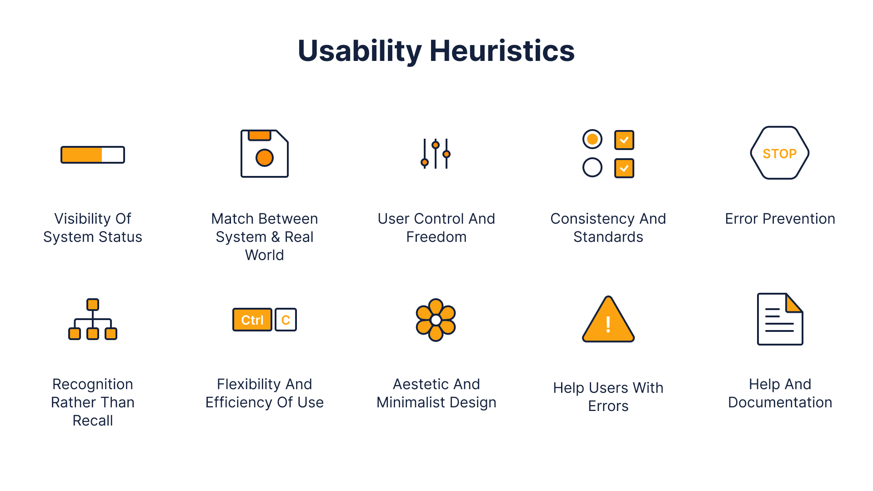

Design+Security
-emphasised the importance of security through our use cases in the website
-consistent styling and layouts throughout pages which meets usability heuristic, aesthetic and minimalist design

Slide 6
Use Cases
Key Use Cases:
Login with 2FA and Recaptcha: user can login to the system after entering their details to perform user tasks
Book Annual Leave(all users/employees): all employees have the option to book annual leave but this must be approved by an internal staff
Update Personal Info(all users/employees): all users can update their personal information
Approve Annual Leave(Internal Staff): internal staff can approve those who request annual leave
Add Employee To The System(Internal Staff): internal staff can add employees on the system
Assign Skill Development Tasks(Trainer): trainer assigns a group/user tasks to complete by a given date
Chatbot: personal assistant to help users answer any simple enquiries
Announcements: all users are notified on any updates
Additional Features include:
To-do List
Support Desk
Select Projects
Submit Timesheets and Expense Reports(Consultants)

Slide 7
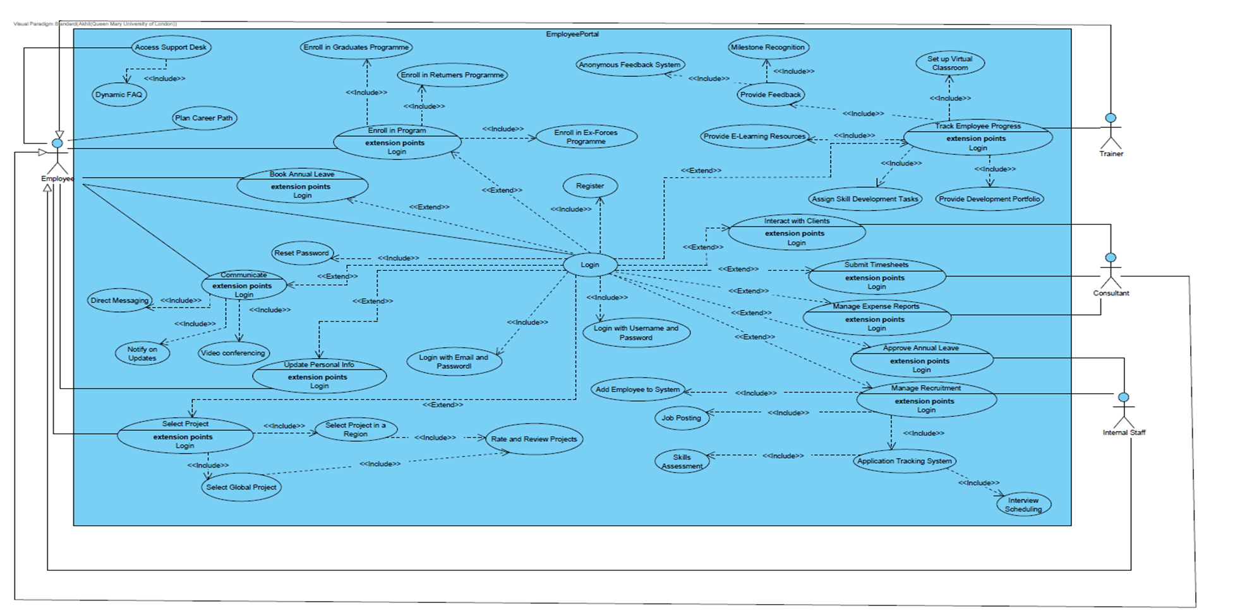
Use Case Diagram

